Slide 1
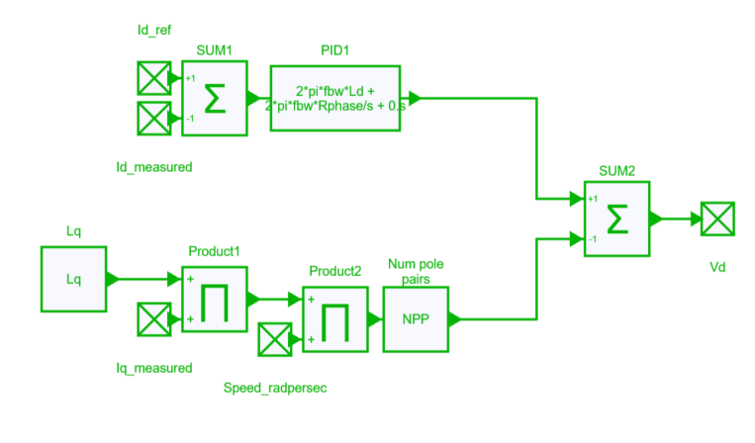
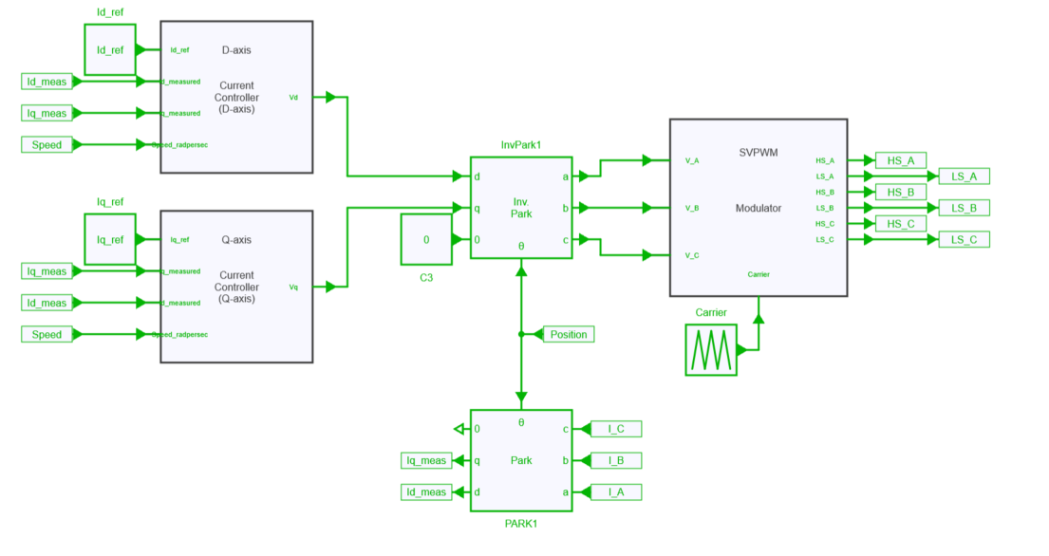
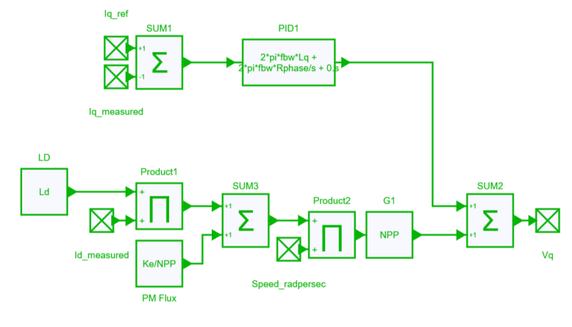
Modulation strategy

Slide 2
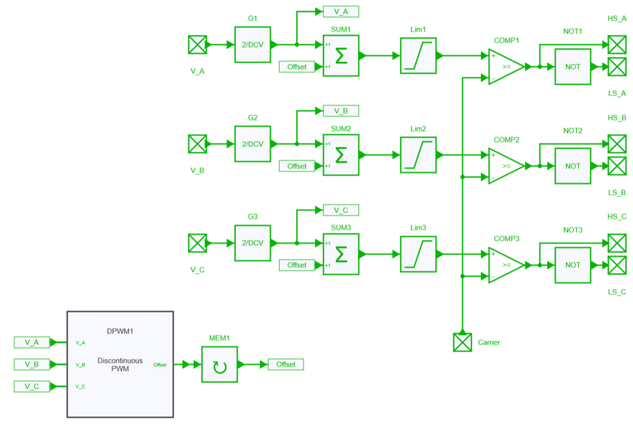
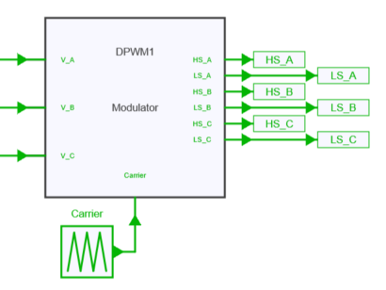
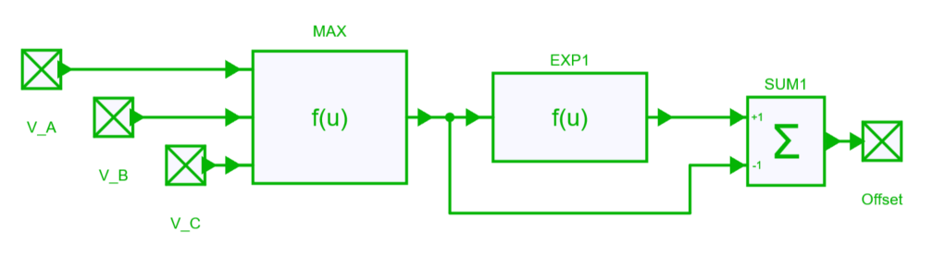

Slide 3
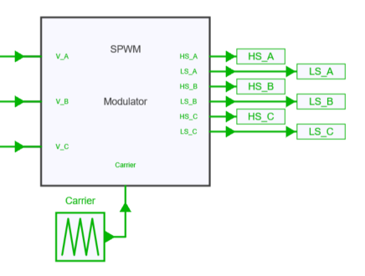
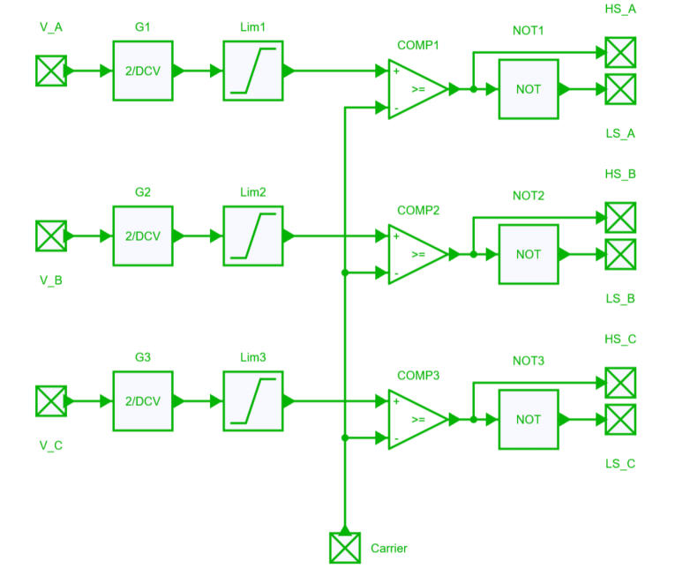

Slide 4
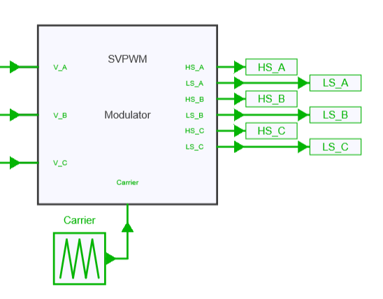
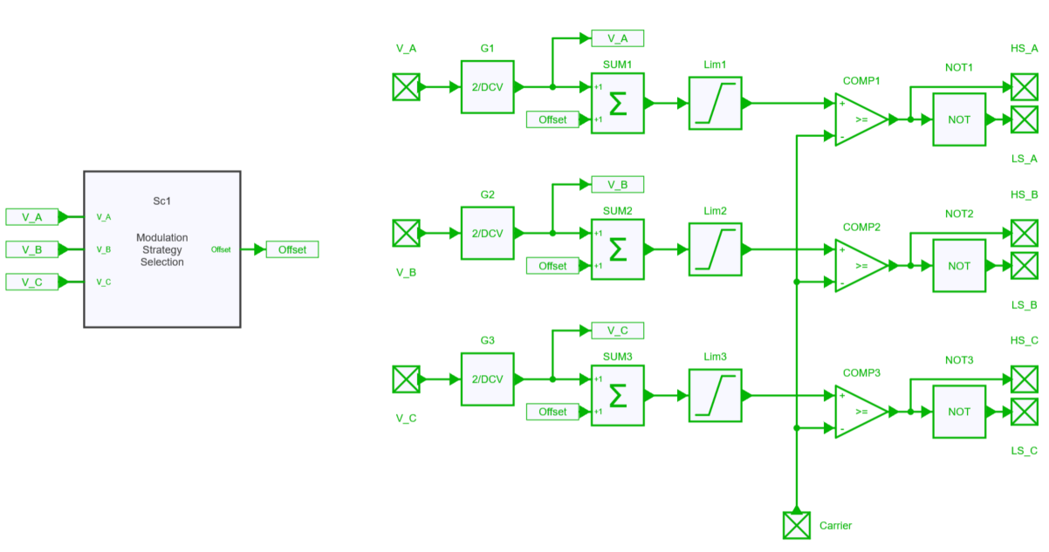
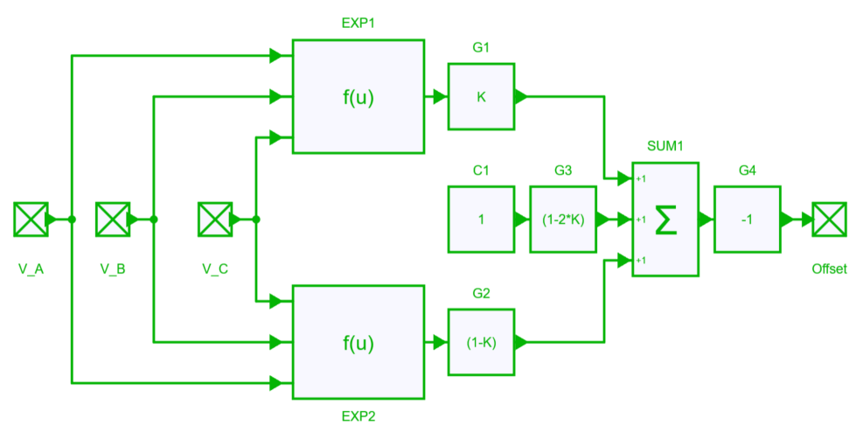

Slide 5
Operating point | Guidelines for frequency determination
Low speed, high load ( point B) | Reduce losses by lowering switching frequency
Low speed, low load ( point A) High speed, low load ( point D) | Reduce losses by increasing switching frequency
Low speed, low load ( point C) | Changing the switching frequency does not significantly affect losses
Operating point | Speed [rpm] | Torque [N・m] | I [A] | β [°] | Id[A] | Iq[A]
B | 2000 | 250 | 222.38 | 44.92 | -157.47 | 157.03
D | 4000 | 20 | 22.50 | 30.81 | -19.32 | 11.52
B
Torque [N・m]
D
Speed [rpm]

